Slide 1
Weather Forecasting Using Machine Learning
su
Under the supervision of
Dr. N. VENKATESH
Associate Professor School of
Computer Science & Artificial Intelligence
Presented for
Milestone 3-Final Minor Project Review
Date:26-04-2024
Candidate No. & Name
HTNO. | Name
2103A52185 2103A52022 2103A52046 2103A52147 | PREETHAM KASARLA GANESH KORE NITHIN REDDY AJAY RAO

Slide 2
Outline of the Presentation
S. No | Topic
1 | Abstract
2 | Introduction
3 | Literature Survey
4 | Research gap identified
5 | TimeLine & Work Progress
6 | Objectives of the Project
7 | Implementation and Results
8 | Conclusion

Slide 3
Abstract
Weather forecasting plays a crucial role in meteorology, offering essential insights into forthcoming atmospheric conditions. This abstract provides a thorough overview of the methodologies employed, challenges encountered, and recent advancements in the field of weather prediction. Weather forecasting is crucial for individuals to plan their activities according to anticipated weather patterns. Meteorologists rely on diverse parameters including temperature, pressure, humidity, dew point, rainfall, precipitation, wind speed, and dataset size to forecast future weather conditions accurately. Data -preprocessing is essential, with a significant portion of data allocated for training purposes.

Slide 4
Introduction
Weather forecasting with machine learning leverages historical weather data to predict future atmospheric conditions. Initially, data from diverse sources, including weather stations and satellites, is collected, encompassing parameters like temperature, humidity, wind speed, and more. Feature selection follows, where relevant variables influencing weather patterns are identified. Subsequently, data preprocessing is conducted to handle anomalies like missing values and outliers while normalizing the dataset for uniformity. The appropriate machine learning model is then chosen, ranging from traditional regression algorithms to advanced neural networks, based on the task's requirements and data characteristics. Following model selection, training commences with historical data, enabling the model to discern underlying patterns.

Slide 5
Major Trends
Integration of Big Data
Advancements in Deep Learning
Ensemble Learning Approaches
Incorporation of Non-traditional Data Sources
Probabilistic Forecasting
Real-time Forecasting and Updates
Interdisciplinary Collaboration

Slide 6
Directions in Weather Foresting
Enhanced Model Interpretability
Integration of Physics-based Models
Spatial and Temporal Resolution Improvement
Uncertainty Quantification
Dynamic Data Fusion
Edge Computing and IoT Integration
Sustainability and Climate Change Adaptation

Slide 7
Literature Review
The literature on weather forecasting with machine learning explores diverse methodologies, applications, and challenges. Methodologically, it encompasses regression models, neural networks, ensemble methods, and Bayesian approaches, often evaluating their performance against metrics like MAE, MSE, and correlation coefficients. Researchers delve into data sources ranging from ground observations to satellite imagery, emphasizing preprocessing techniques to ensure data quality. Feature selection and engineering are vital, with studies investigating informative variables and derived features for improved model performance. Application-wise, weather forecasting supports sectors such as agriculture, energy, transportation, and disaster management, aiding decision-making and risk mitigation. Challenges include data scarcity, model interpretability, uncertainty quantification, and computational complexity, prompting future directions focused on interdisciplinary collaboration, advanced model development, integration of new data sources, and technological advancements.

Slide 8
Important points derived through Literature reivew
Studies consistently show the effectiveness of machine learning techniques, such as neural networks, decision trees, and ensemble methods, in improving the accuracy of weather forecasts compared to traditional methods.
The quality of input data significantly impacts the performance of forecasting models.
Integrating diverse data sources, including weather station observations, satellite imagery, and numerical weather prediction models, enhances the robustness and reliability of forecasting models, especially for capturing spatial and temporal variability.
Studies highlight the importance of high spatial and temporal resolution in weather forecasting models for accurately capturing local weather phenomena and providing timely predictions.

Slide 9
Scientometric/ systematic Analysis
Inclusion Criteria
Exclusion Criteria
Relevance to the Topic
Methodological Approach
Publication Type and Status
Temporal Coverage
Language
Data Sources
Irrelevant Topic
Inadequate Methodology
Duplicate Publications
Publication Status
Low Data Quality
Outdated Publications

Slide 10
THE KNOWLEDGE GAP
Meteorological Principles: Understanding atmospheric dynamics, thermodynamics, and fluid mechanics is crucial for interpreting weather data and developing accurate forecasting models.
Machine Learning Techniques: Proficiency in regression, classification, clustering, and deep learning algorithms is necessary for building predictive models using weather data.
Data Preprocessing: Skills in data cleaning, feature engineering, and exploratory data analysis are essential for handling large volumes of weather data effectively.
Statistical Methods: Knowledge of statistical techniques and probability theory is important for model validation, uncertainty quantification, and hypothesis testing in weather forecasting research.
Geographic Information Systems (GIS): Familiarity with GIS tools enables spatial analysis and visualization of weather data, facilitating geographical mapping and localized predictions.

Slide 11
Objectives -
Objective 1
Improving Forecast Accuracy: Enhancing the accuracy and reliability of weather predictions is a primary objective.
Objective 2
Enhancing Lead Time: Another objective is to increase the lead time of weather forecasts, providing advanced warning to individuals, businesses, and organizations.
Objective 3
Tailoring Forecasts for Specific Applications: The project also focuses on tailoring weather forecasts to meet the specific needs of different user groups and applications.

Slide 12
Gaps identified
Lack of Accuracy:
Current weather forecasting models have limitations in accurately predicting weather patterns.
Limited Data Sources:
Reliance on traditional weather data sources, such as ground-based sensors, can restrict the scope of analysis.
Slow Adaptation :
Existing systems struggle to quickly adapt to rapidly changing weather conditions and new data sources.
While traditional weather forecasting methods have provided valuable insights, the emergence of advanced machine learning techniques presents an opportunity to address the gaps in accuracy, data sources, and adaptability. By leveraging the power of machine learning, we can develop more robust and responsive weather forecasting systems that can better serve the needs of modern society.

Slide 13
Timeline & Work Plan/ Progress
JANUARY ’24 | FEBRUARY ’24 | MARCH’24 | APRIL’24
[ Collection of relevant literature Scientometric Analysis of Literature Finalisation of the topic | learn Python packages build simple model search for data sets | Testing of the Model on Context data Saccasam and Multi domain
Study of Literature
Building the Model
Training &Testing
Report Preparation
Project report preparation

Slide 14
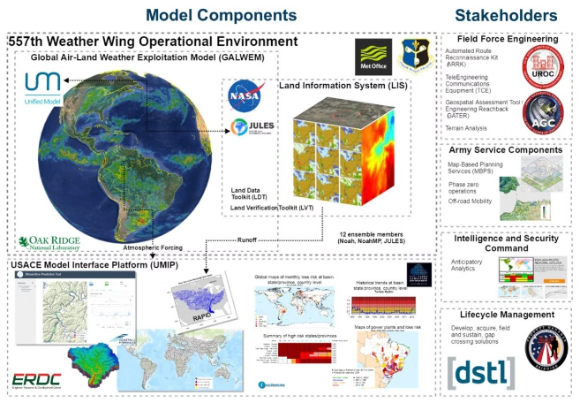
Existing system
The existing weather forecasting system relies heavily on complex mathematical models and large-scale simulations. These models use data from weather stations, satellites, and other sensors to predict weather patterns and trends.
While effective, the existing system can be limited by the availability and accuracy of input data, as well as the computational power required to run these complex models.

Slide 15
Disadvantage of Existing system
Limited Accuracy
Lack of Adaptability
High Costs
Delayed Responses
Traditional weather forecasting methods often struggle to provide accurate predictions, especially for complex weather patterns and extreme events.
Existing systems may fail to adapt quickly to changing environmental conditions and new data sources, limiting their ability to improve over time.
Maintaining and upgrading traditional weather forecasting infrastructure can be expensive, making it inaccessible for some regions and communities.
Conventional forecasting methods may take time to process data and generate predictions, hindering the ability to respond quickly to rapidly changing weather conditions.

Slide 16
Problem Identification
3
Key Challenges
Existing weather forecasting approaches have 3 major limitations that need to be addressed.
The current weather forecasting methods, while useful, have several significant shortcomings that limit their accuracy and effectiveness. These include the inability to fully capture complex atmospheric patterns, the difficulty in processing large volumes of data in real-time, and the need for more robust machine learning techniques to improve predictive capabilities.

Slide 17
Dataset discription
This dataset contains weather-related information for the period from January 1st, 2020 to December 29th, 2020. It includes the following columns:
Date: The date of the recorded weather data.
Temperature: The temperature in degrees Celsius.
Humidity: The relative humidity percentage.
Wind Speed: The wind speed in kilometers per hour.
Weather Condition: Describes the prevailing weather condition on that date (e.g., Sunny, Cloudy, Rainy, Thunder, Normal).

Slide 18
Algorithm Explanation
Data Collection
Gather historical weather data from various sources, including weather stations, satellites, and sensor networks.
Feature Engineering
Identify and extract the most relevant features from the data, such as temperature, humidity, wind speed, and pressure.
Model Training
Apply advanced machine learning algorithms, such as neural networks or decision trees, to train predictive models.

Slide 19
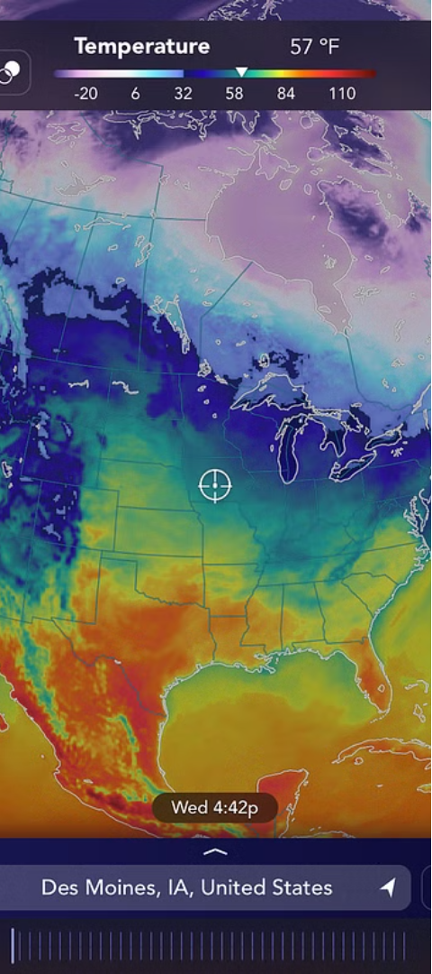
Implementation and Results
Diverse Data Sources
The system integrates real-time data from various sources, including weather stations, satellites, and social media.
Predictive Modeling
Machine learning models are trained on historical data to forecast weather patterns with high accuracy.
Visualization Dashboard
Users can access intuitive data visualizations to better understand and interpret the weather forecasts.
Users can access intuitive data visualizations to better understand and interpret the weather forecasts.

Slide 20



Future Advancements
Satellite Integration
AI-Powered Predictions
IoT Sensor Networks
Leveraging advanced satellite technology to enhance data collection and monitoring of weather patterns.
Implementing more sophisticated deep learning models to further improve the accuracy of weather forecasts.
Implementing more sophisticated deep learning models to further improve the accuracy of weather forecasts.

Slide 21
Conclusions
Improved Accuracy: Machine learning techniques significantly enhance the accuracy of weather forecasting compared to traditional methods. The ability to capture complex patterns and relationships in weather data leads to more precise predictions of meteorological variables.
Enhanced Lead Time: Machine learning models enable the extension of forecast lead times, providing advanced warning for weather-related events.
Customized Solutions: Tailoring forecasting models to specific applications and user needs enhances the relevance and usefulness of weather forecasts. Customized solutions for sectors such as agriculture, transportation, and disaster management optimize decision-making and resource allocation strategies.
Integration of Data Sources: Integrating diverse data sources, including weather station observations, satellite imagery, and numerical models, improves the robustness and reliability of forecasting models.

Slide 22
References
[1] | Weather Forecasting Using Ensemble Learning with Feature Selection,
[2] | Weather Prediction with Transfer Learning using Convolutional Neural Network
[3] | Machine Learning in Weather Prediction and Climate Analyses

Slide 23
THANK YOU

